Slide 1
Magnetron sputtered titania and carbon fiber cloth composite and its application in electrochemical supercapacitors
APPLICATIONS OF CHEMISTRY
IN NANOSCIENCES
AND BIOMATERIALS ENGINEERING
NanoBioMat 2022 – Summer Edition
22-24 June 2022
Kozlov Aleksei P.^{1,2*}, Arkhipova Ekaterina A.¹, Savilov Serguei V.¹
¹Chemistry Department of M. V. Lomonosov Moscow State University
²Moscow Aviation Institute (National Research University)
kozlov.aleksei.p@gmail.com

Slide 2
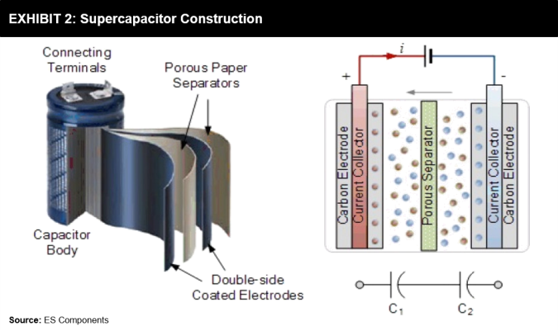
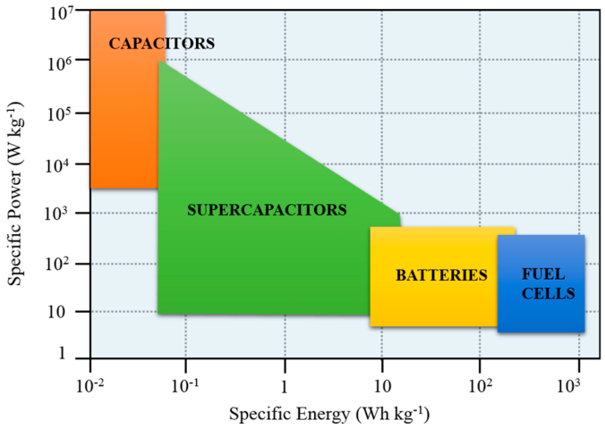
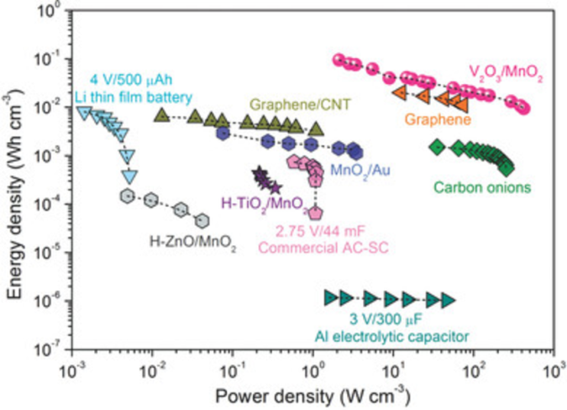
Introduction
APPLICATIONS OF CHEMISTRY IN NANOSCIENCES AND BIOMATERIALS ENGINEERING
NanoBioMat 2022 – Summer Edition 22-24 June 2022
2
noaa.gov; teriin.org
futurebridge.com; mdpi.com; 10.1002/advs.201500319

Slide 3
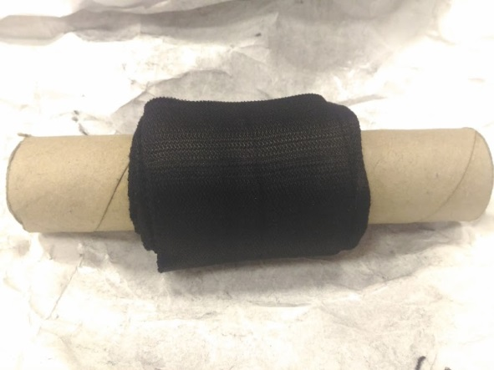
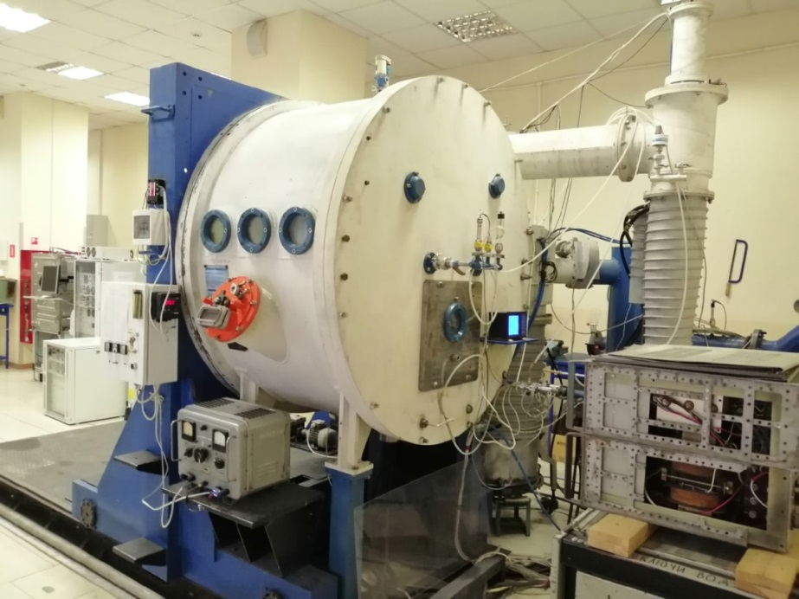
Creating composite material for supercapacitor application
APPLICATIONS OF CHEMISTRY IN NANOSCIENCES AND BIOMATERIALS ENGINEERING
NanoBioMat 2022 – Summer Edition 22-24 June 2022
3
Commercial Carbon Fiber cloth
Titania was coated on Carbon Fiber using RF magnetron sputtering
Characterization:
Scanning Electron Microscopy, Raman Spectroscopy, X-Ray Diffraction, X-Ray Photoelectron Spectroscopy, Electron Paramagnetic Resonance, Thermal analysis, Pore Analysis, Electrochemical analyses

Slide 4
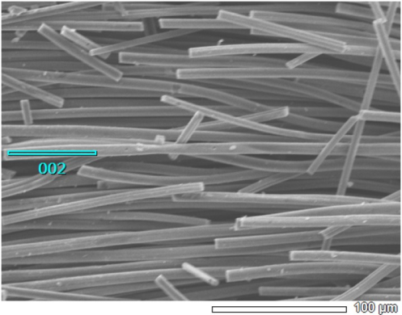
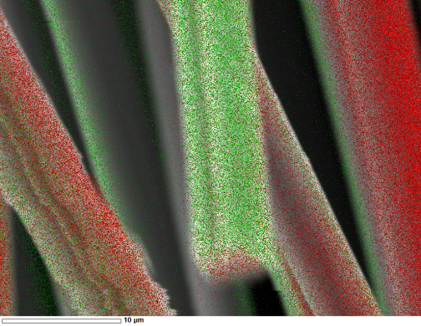
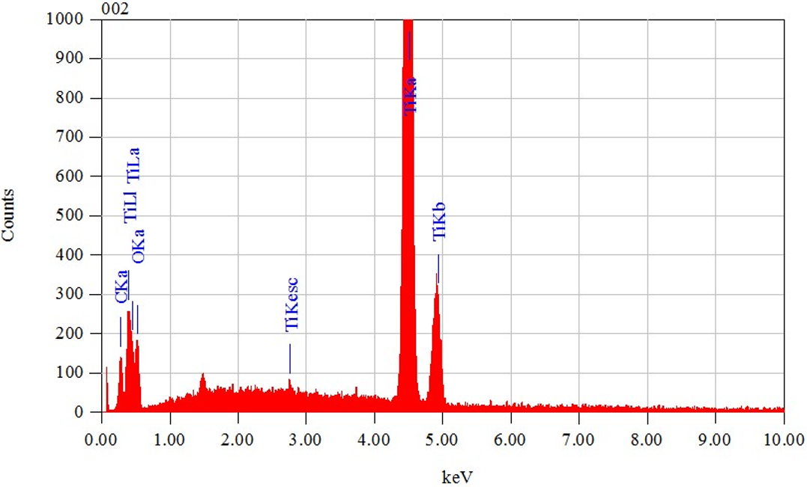
Scanning Electron Microscopy
APPLICATIONS OF CHEMISTRY IN NANOSCIENCES AND BIOMATERIALS ENGINEERING
NanoBioMat 2022 – Summer Edition 22-24 June 2022
4
Carbon Fiber
Ti coated Carbon Fiber

Slide 5
Raman Spectroscopy, X-Ray Diffraction
APPLICATIONS OF CHEMISTRY IN NANOSCIENCES AND BIOMATERIALS ENGINEERING
NanoBioMat 2022 – Summer Edition 22-24 June 2022
5
X-ray diffraction demonstrates broad peak at 2θ≈36°, suggesting a (101) plane of Rutile, polymorph of TiO2;
Raman spectrum of carbon region shows distinct D and G bands, typically accociated with defects and in-plane vibrations of sp2-carbon, respectively.

Slide 6
X-Ray Photoelectron Spectroscopy, Electron Paramagnetic Resonance
APPLICATIONS OF CHEMISTRY IN NANOSCIENCES AND BIOMATERIALS ENGINEERING
NanoBioMat 2022 – Summer Edition 22-24 June 2022
6
Survey spectrum shows 3 major elements, C, O, Ti and negligible amount of N;
C1s region suggests that Carbon Fiber is functionalized by oxygen-containing groups;
Ti2p region demonstrates high amount of Ti⁴⁺ and almost no Ti⁰
EPR showed no signal of Ti³⁺

Slide 7
Thermal analysis
APPLICATIONS OF CHEMISTRY IN NANOSCIENCES AND BIOMATERIALS ENGINEERING
NanoBioMat 2022 – Summer Edition 22-24 June 2022
7
20-450 °C region: prolonged water evaporation from material, resulting in 2.5% mass loss;
450-700 °C region: being also highly exothermic, shows a rapid mass loss, from 97.5 to 12%, suggesting a reaction of carbon oxidation by air oxygen and the TiO2 loading content of 12%.
700-900 °C region with mass increase of 1% can be attributed to oxidation of residual metallic Ti.

Slide 8
Pore analysis
APPLICATIONS OF CHEMISTRY IN NANOSCIENCES AND BIOMATERIALS ENGINEERING
NanoBioMat 2022 – Summer Edition 22-24 June 2022
8
According to the IUPAC pore classification these are the type I isotherms, therefore material is microporous (pore size <5 nm). Isotherms demonstrate a hysteresis loop of type H4, suggesting a “slit” pore type.
Applied pore calculation method QSDFT estimates specific surface area value of 1210.7 m² g-1, 12,5% less than that of initial Carbon Fiber.
Pore size distribution shows that majority of pores are micropores.

Slide 9
Supercapacitor performance
APPLICATIONS OF CHEMISTRY IN NANOSCIENCES AND BIOMATERIALS ENGINEERING
NanoBioMat 2022 – Summer Edition 22-24 June 2022
9
Electrochemical Impedance Spectroscopy
Cyclic Voltammetry
Specific Capacitance – Scan Rate
Cycle Efficiency

Slide 10
Conclusion
APPLICATIONS OF CHEMISTRY IN NANOSCIENCES AND BIOMATERIALS ENGINEERING
NanoBioMat 2022 – Summer Edition 22-24 June 2022
10
Titania was successfully applied on the Carbon Fiber cloth by magnetron sputtering, exhibiting an uniform coating;
Titania was found to be in Rutile polymorph, with negligible amounts of metallic Ti. Ti³⁺ centers were not detected;
Carbon Fiber demonstrated both rich O-containing surface functionalities and microporous structure with a developed surface area, that were mostly inaffected by titania coating;
Resulting Titania coated Carbon Fiber composite material showed better impedance response, electrochemical activity, cycle efficiency compared to initial Carbon Fiber, and comparable specific capacitance.
Acknowledges: Korobeinikov Evgeniy, Chekmaryov Dmitriy, Oksana Isaikina, Maslakov Konstantin, Kupreenko Stepan, Suslova Evgeniya.
Thank you for your attention!

