Slide 1

RELIC PERIGLACIAL FEATURES AND THEIR IMPACT ON MODERN SOIL REDISTRIBUTION PROCESSES ON CULTIVATED SLOPES of the Western European Russia
V.R. BELYAEV, A.L. GURINOV, A.E. SEMOCHKINA, I.D. STRELETSKAYA,
S.V. KHARCHENKO, N.N. LUGOVOY and T.A. PARAMONOVA
Lomonosov Moscow State University, Moscow, Russia
vladimir.r.belyaev@gmail.com

Slide 2
Main purposes of this talk:
to provide an overview of the current knowledge on types and distribution of the relic periglacial features within the western part of the Russian Plain
to show examples of such features directly observed in the field
to discuss the influence of periglacial processes on fluvial processes including human-accelerated soil and gully erosion in the past and at present
to determine perspectives for the future research

Slide 3
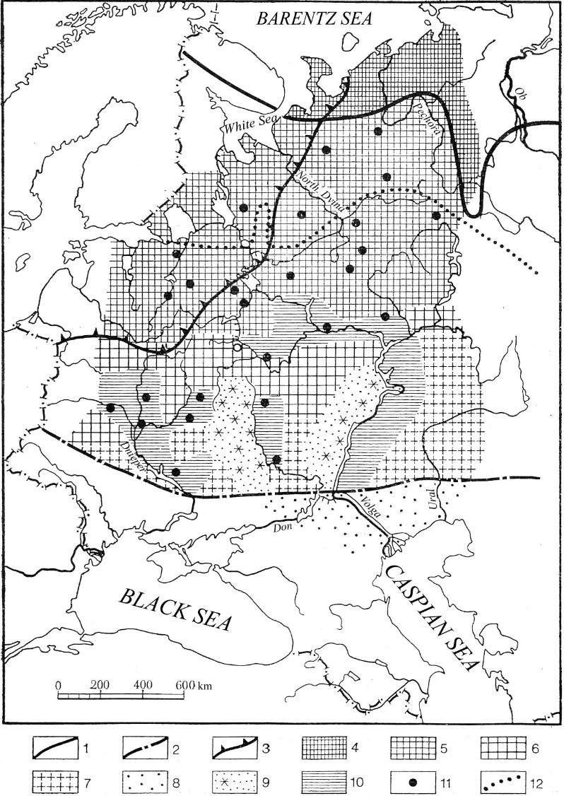
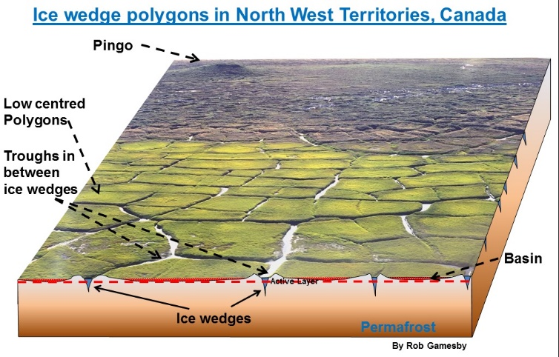
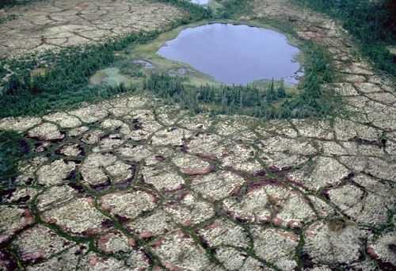
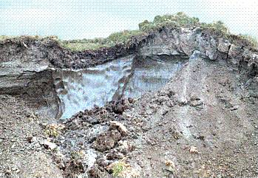
Types of periglacial features reflected
in the modern topography of the Russian Plain
1 – Southern extent of the modern permafrost
2 – Southern extent of the maximum Late Quaternary permafrost
3 – Southern extent of the Late Quaternary (Valday) glaciation
4-7 – Different types of polygonal topography
8-9 – Different types of linear slope depressions (hollows)
10 – Aeolian features on large river terraces
11 – Groups of large thermokarst depressions
© Emma Oldham
Map from Velichko, 1973

Slide 4
Polygonal features examples
Linear features examples

Slide 5
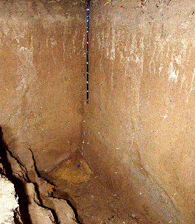
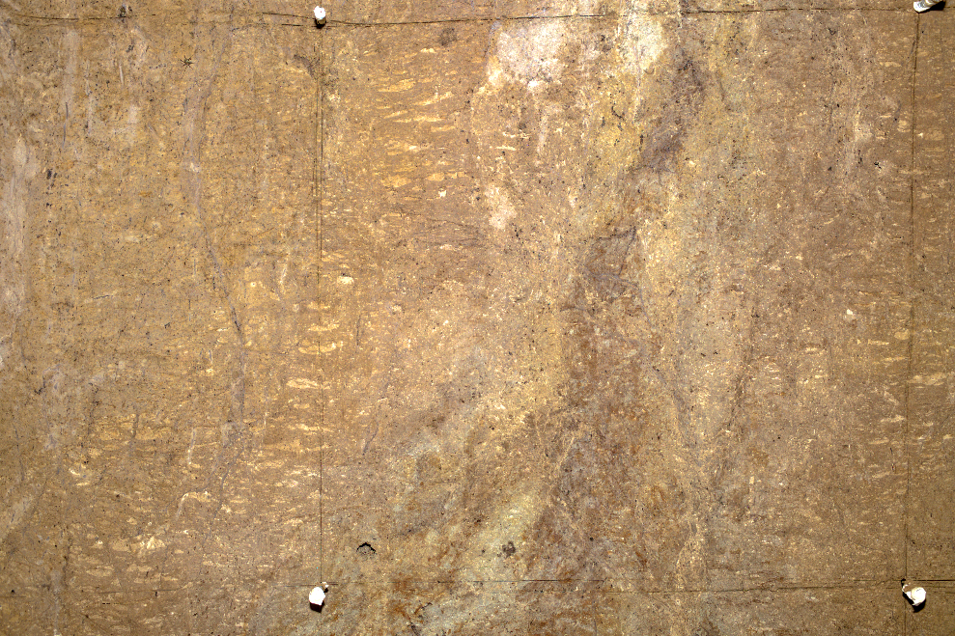
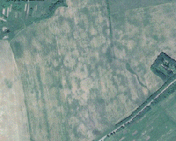
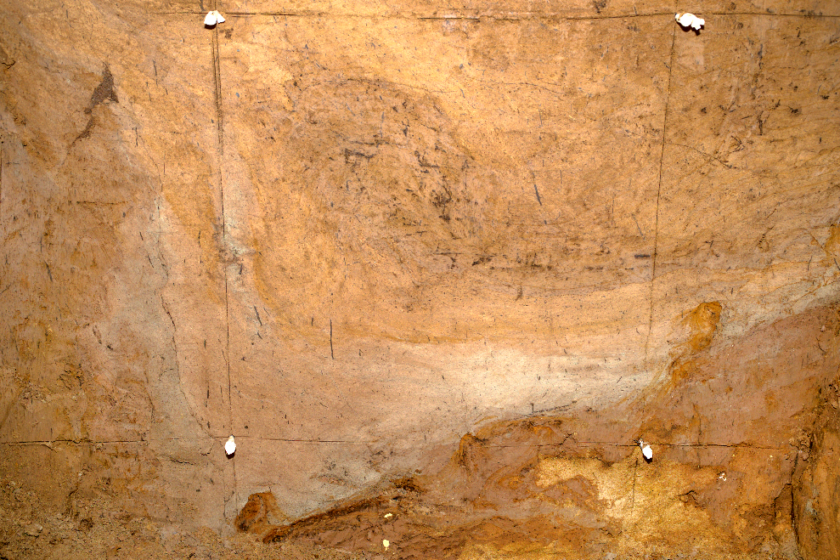
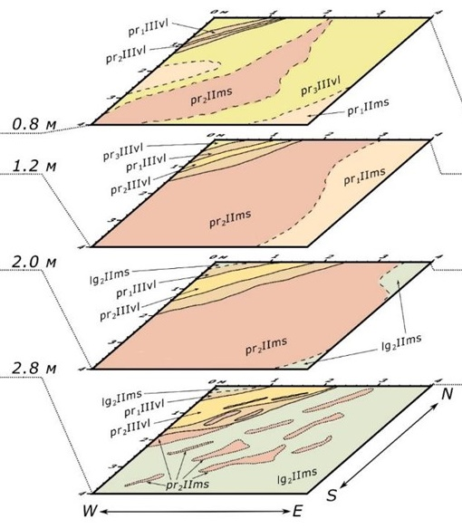
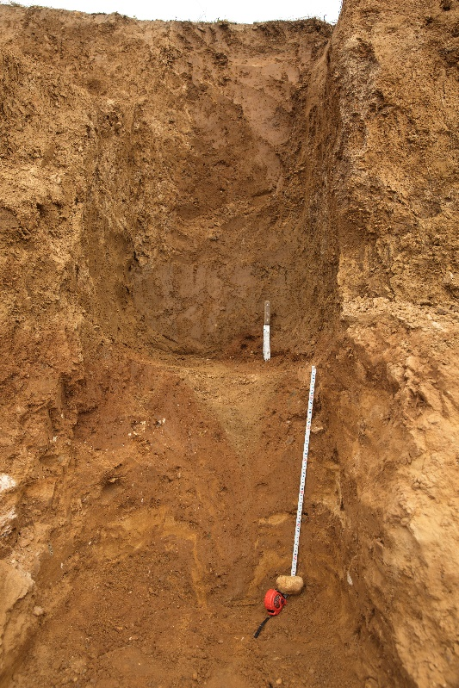
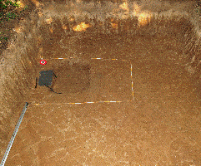
1
Color and texture difference between large cryostructure and surrounding matrix,
W wall of the main section
Large (up to 15-20 m) polygonal features
evident on satellite images of the modern landscape
of cultivated interfluves
0.5 m
0.5 m
Cryoturbations at the structures base,
N wall of the main section
Large cryostructure and smaller
Frost cracks on N and W walls of
the main section
Smaller wedge-shaped cryostructure in the E wall of the open sand and gravel quarry
0.5 m
Network of small frost crack polygons
(15-20 cm) on temporary bottom during
digging of the main section
1.0 m
0.5 m
Interfluve surface sections and images showing
different scales of buried cryogenic structures,
SW of the Yaroslavl Region, the Upper Volga Basin. Photos by I.G. Shorkunov, E.V. Garankina

Slide 6
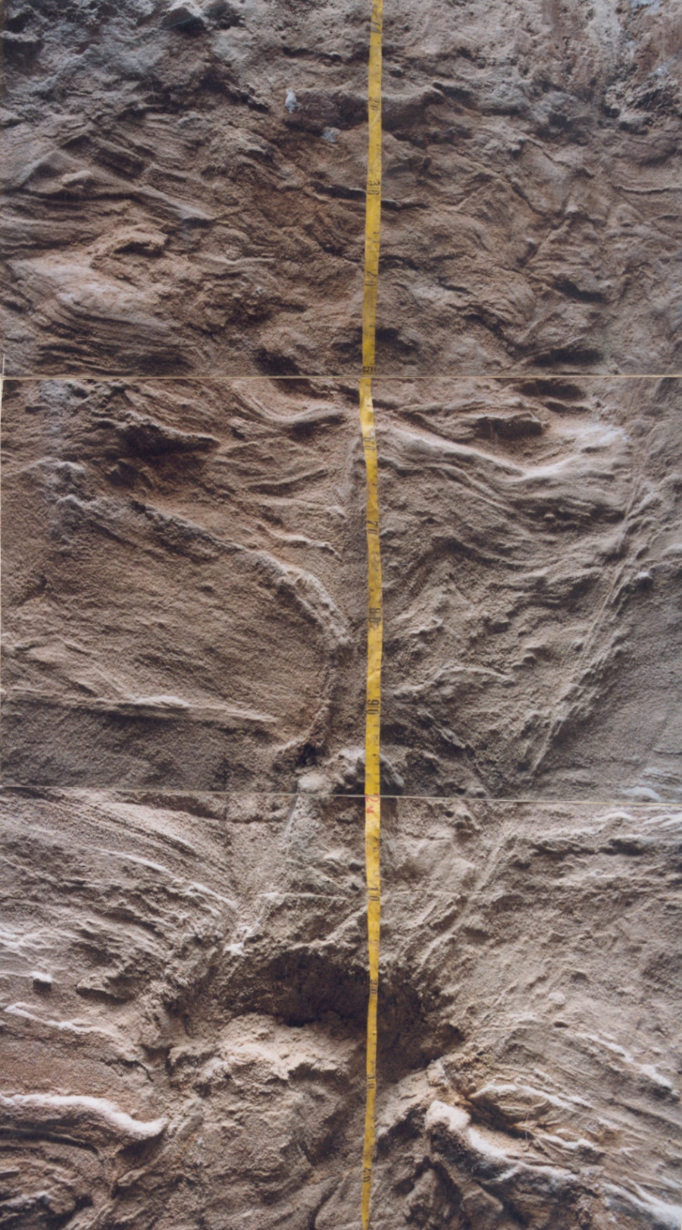
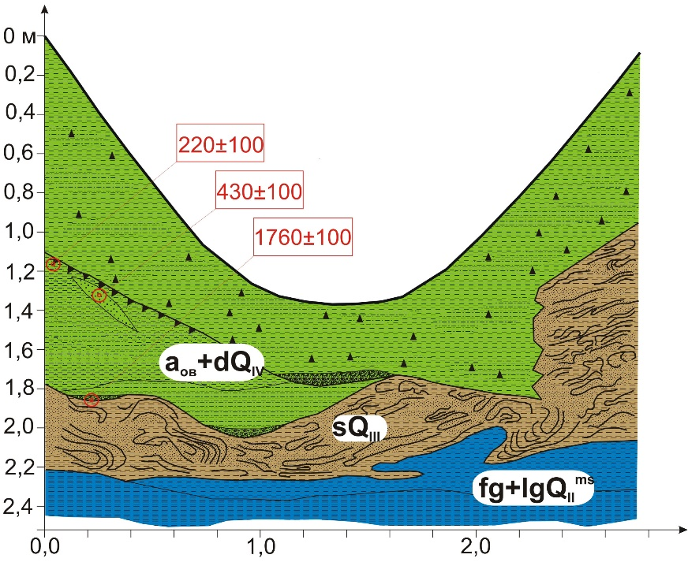
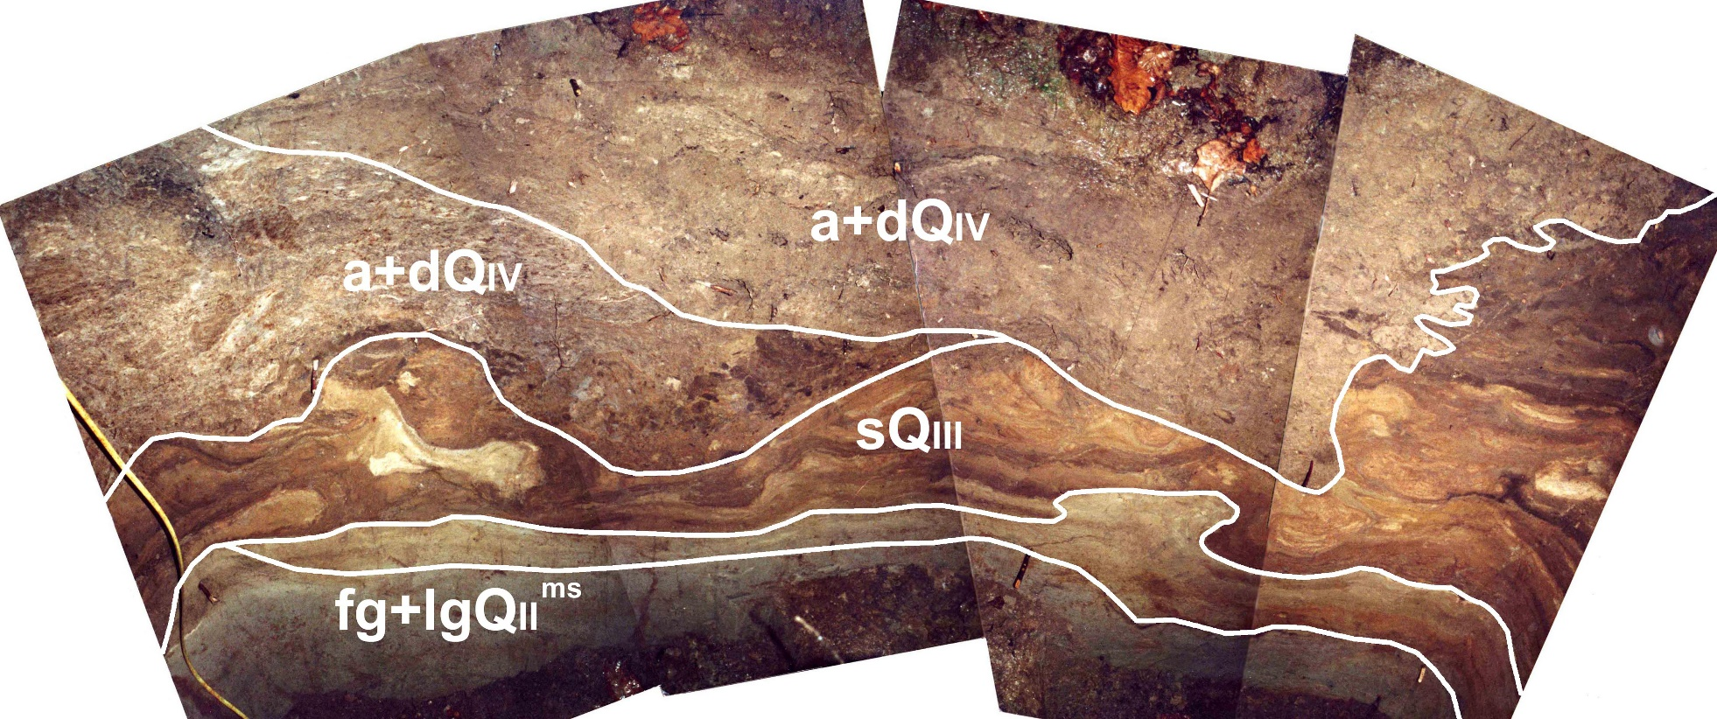
2
Sand wedge (about 1.5 m deep and up to 0.5 m wide) with surrounding smaller scale cryoturbations in the Late Pleistocene alluvial sands of the Protva River valley (Kaluga region)
1,5 м
Layer of mixed sandy and silty loam with laminations and lenses contorted by periglacial mass movement (solifluction), filling the bottom of depression, which later became cut by the Holocene gully (younger sediment layers). The Protva River basin (Kaluga region)
Photos by N.N. Lugovoy
2 м

Slide 7
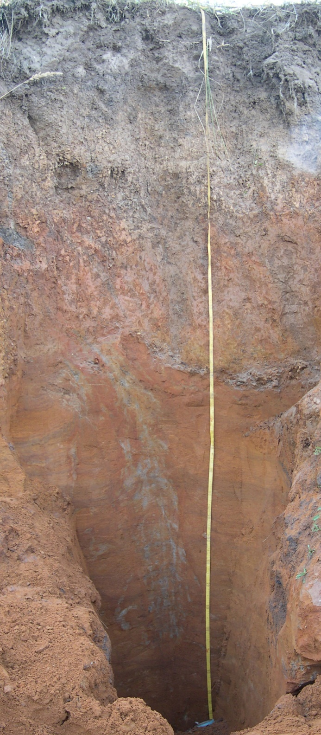
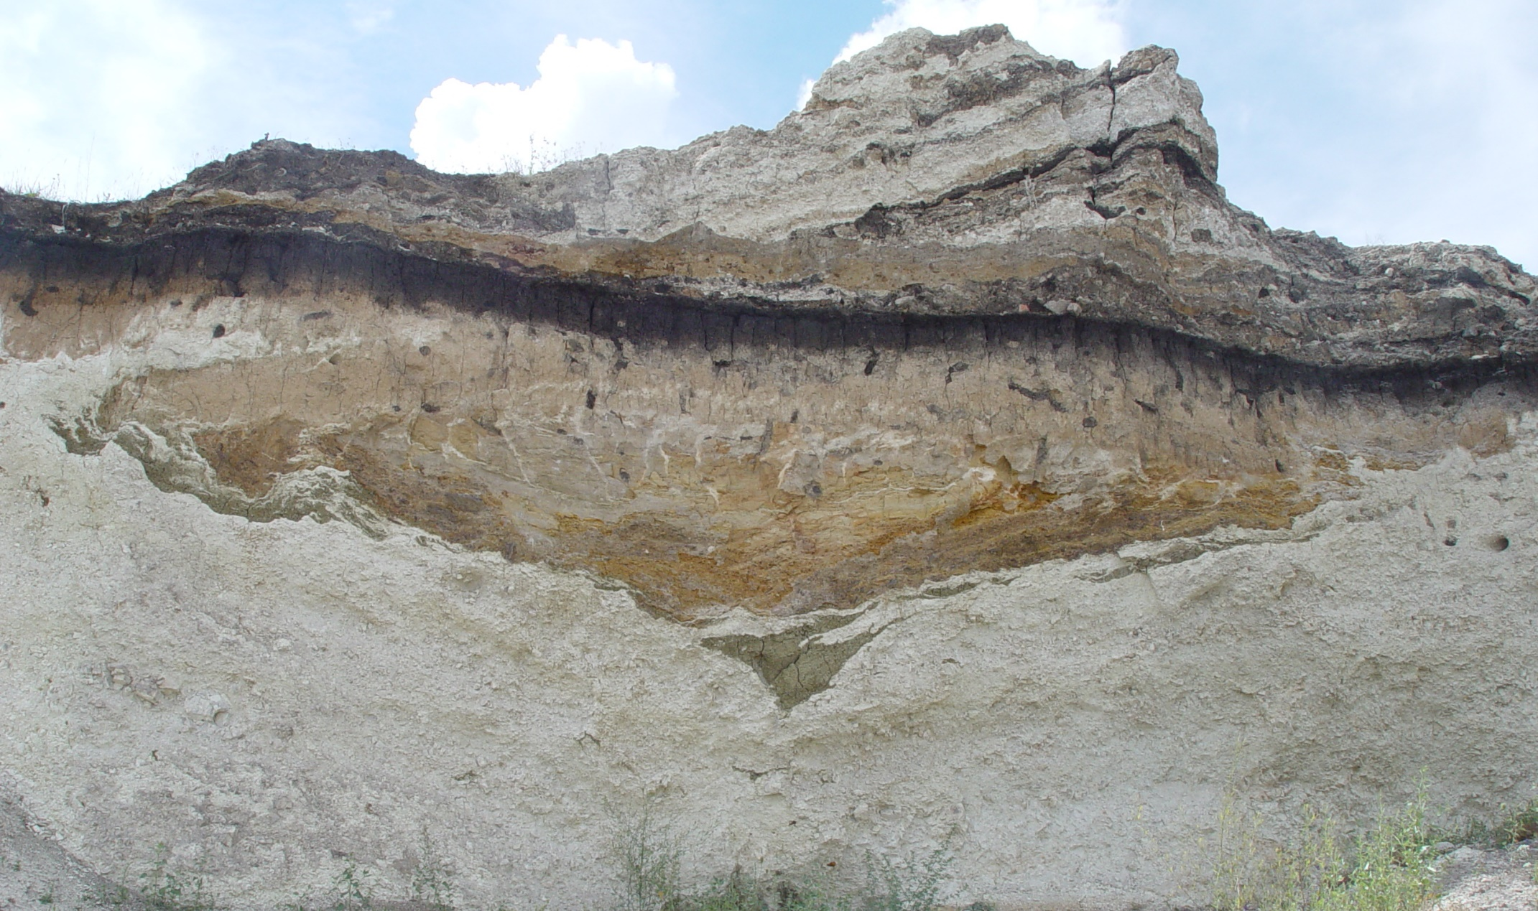
3
Silty sand wedge (about 2 m deep and up to 0.5 m wide) in the Middle Pleistocene laminated limnoglacial deposits on flat interfluve within the Zusha River basin (Orel Region)
Buried gully initially incised into the large ice wedge pseudomorph, the Kursk Region
4
1 м
2 м
3 м
Photo by A.V. Panin

Slide 8
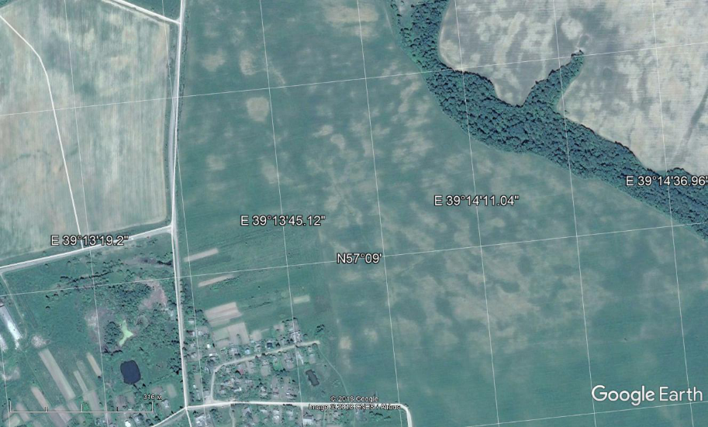
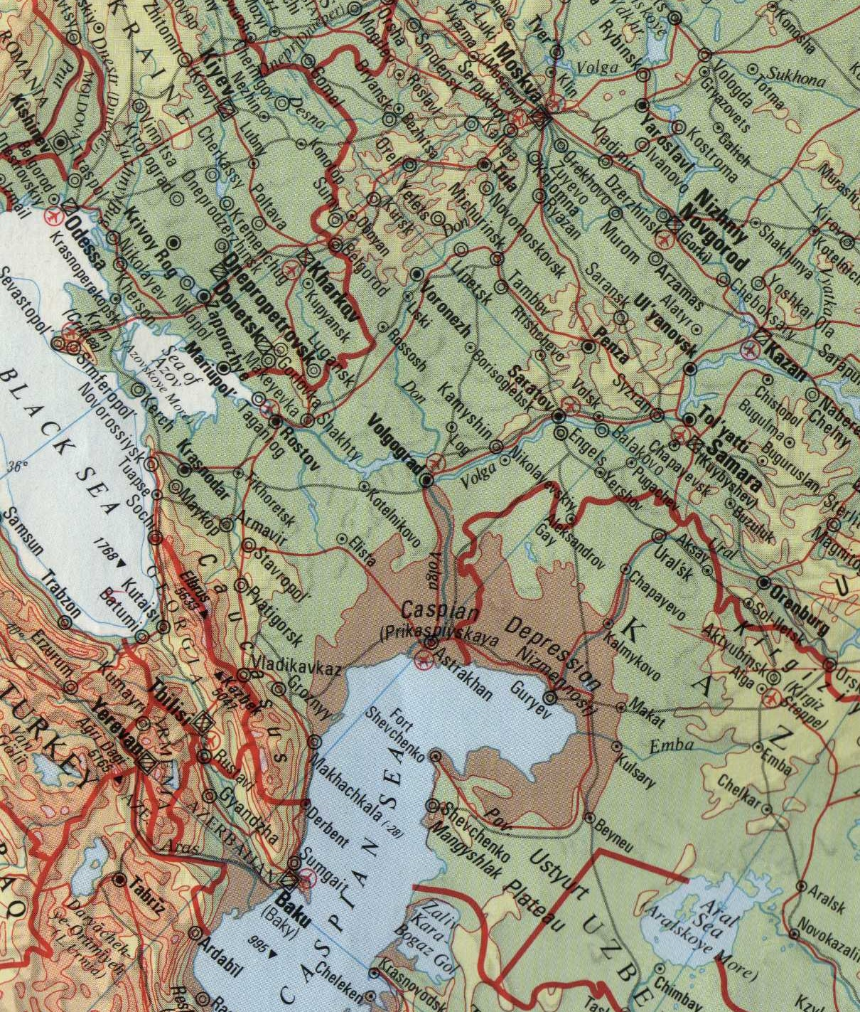
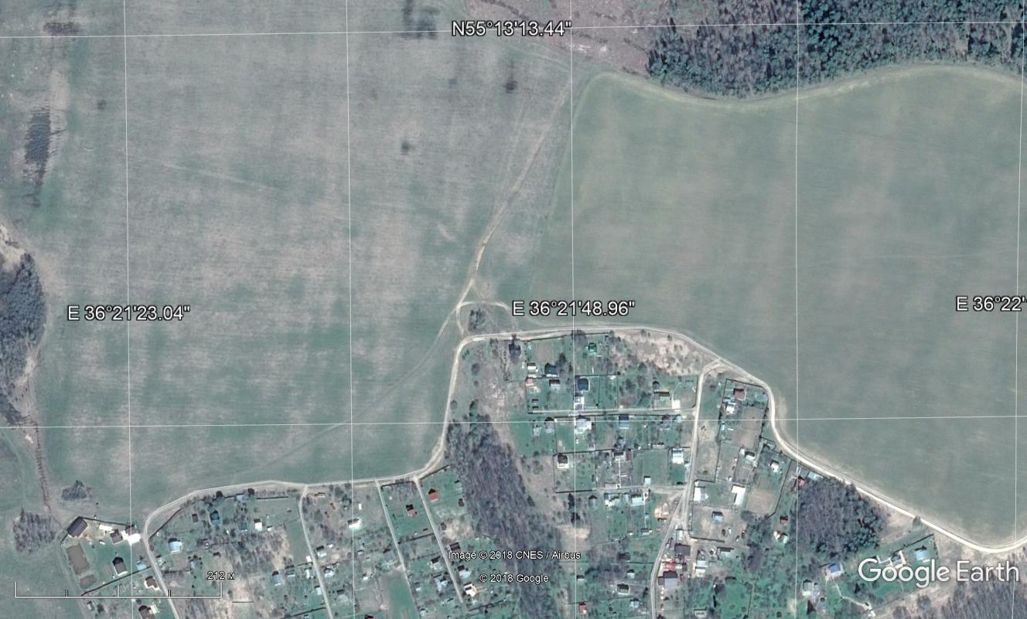
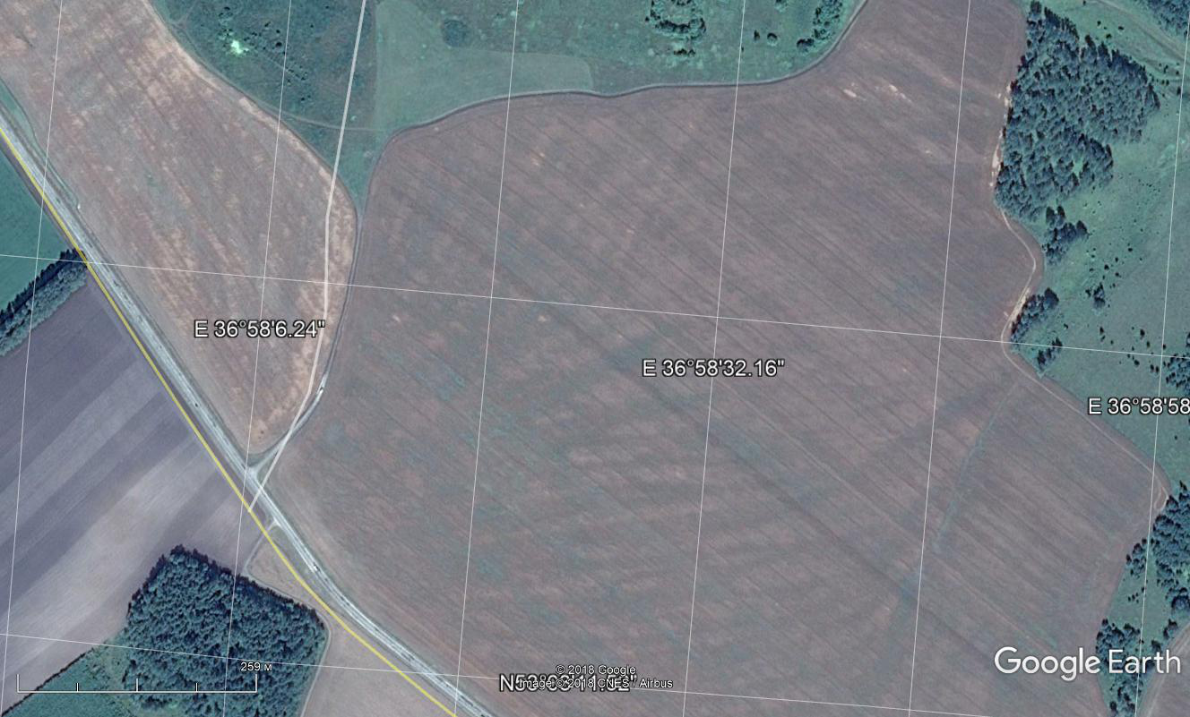
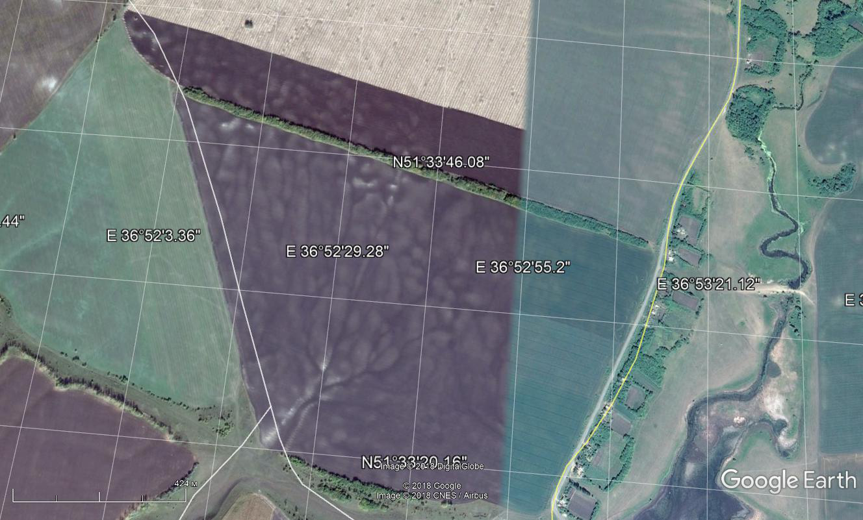
2
1
3
4
1
2
3
Yaroslavl Region – boreal forest, Albeluvisols Umbric (ABum);
Kaluga Region – mixed forest, Albeluvisols Umbric (ABum);
Orel Region – broadleaved forest, Phaeozems Albic (PHab) soils;
Kursk Region – forest-steppe, Chernozems Chernic (CHch) soils
4

Slide 9
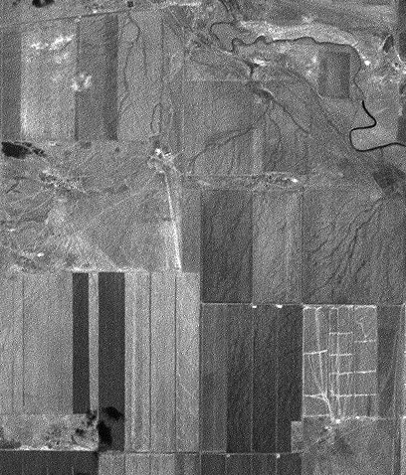
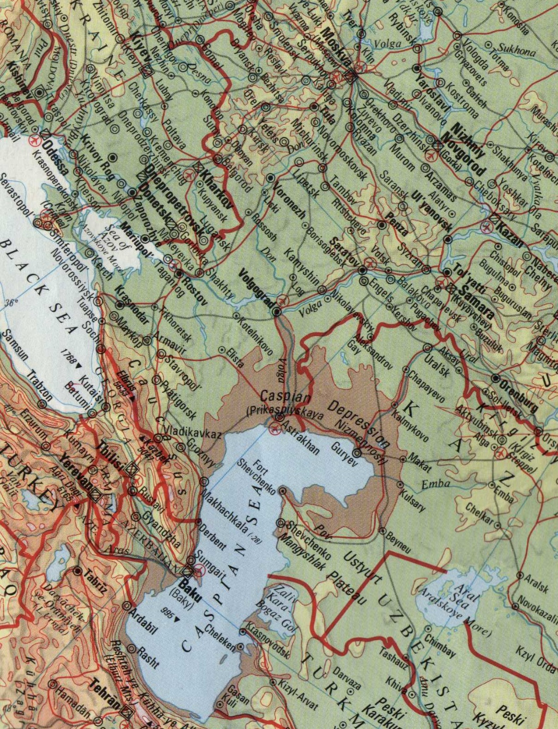
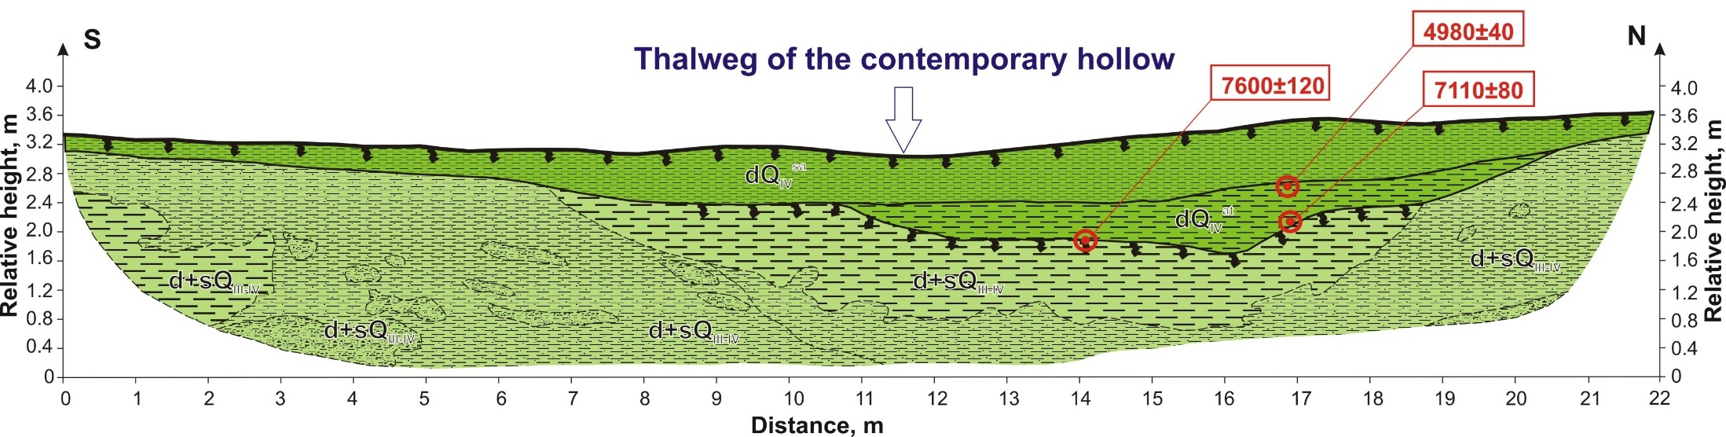
5
Stavropol Upland, Kalaus River basin, S of the Russian Plain.
Dry steppe, Kastanozems Haplic (Ksha) soils.
Dense network of dells and thermoerosion gullies formed under periglacial conditions and later infilled by mass movements (mainly solifluction). After degradation of periglacial conditions these landforms continued to control sediment redistribution.
5

Slide 10
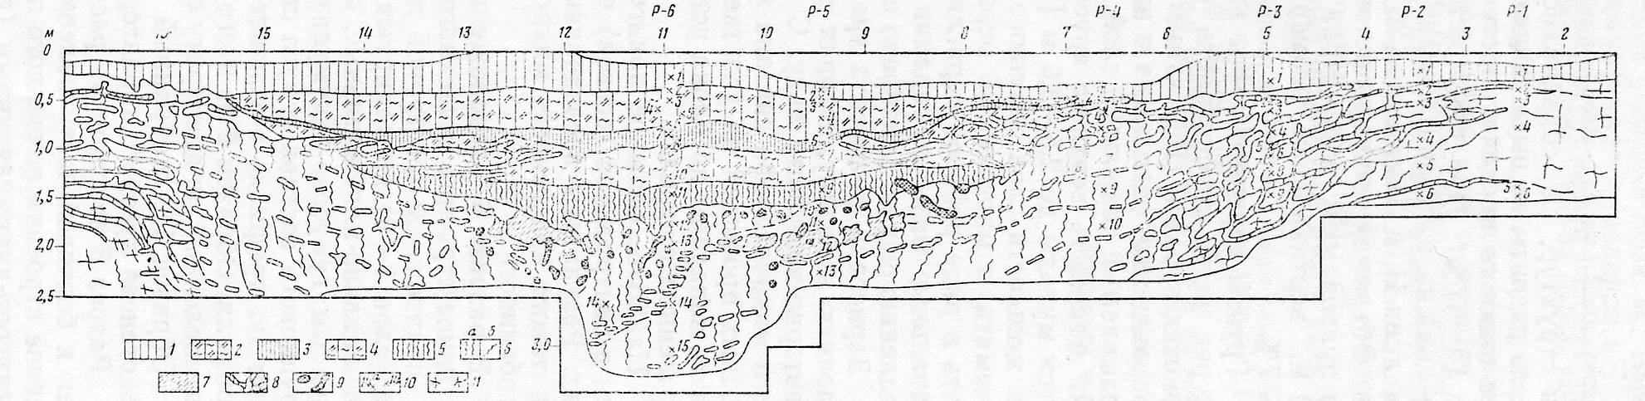

Figure from Velichko et al., 1986
Similar features from different territories: Trubchevskoe Opol’e (above) and Stavropol Upland (below)

Slide 11
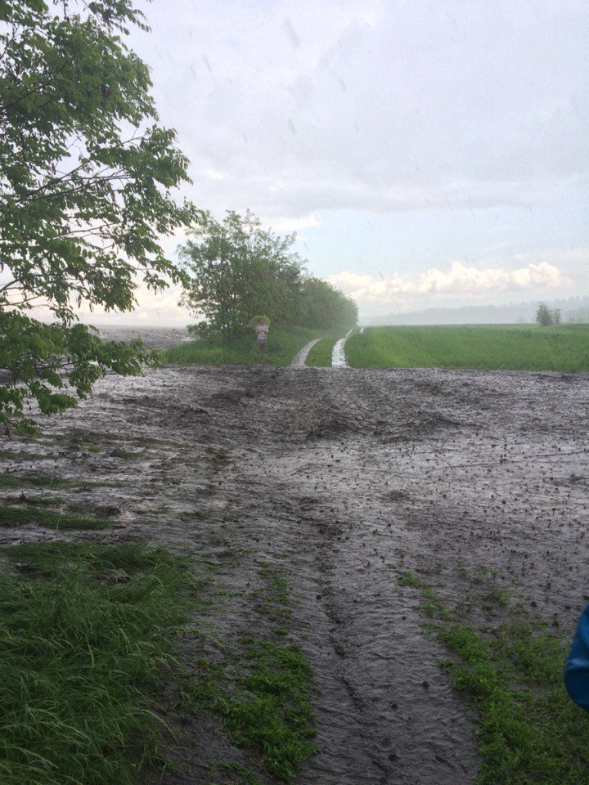
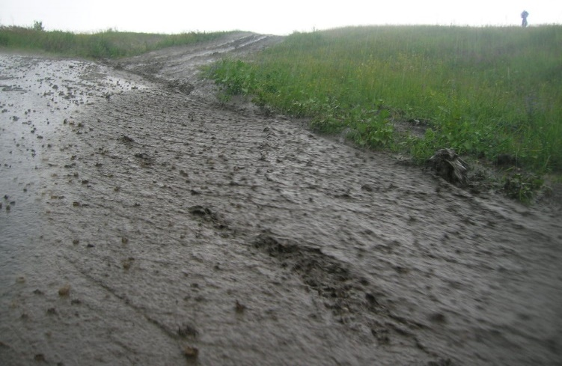
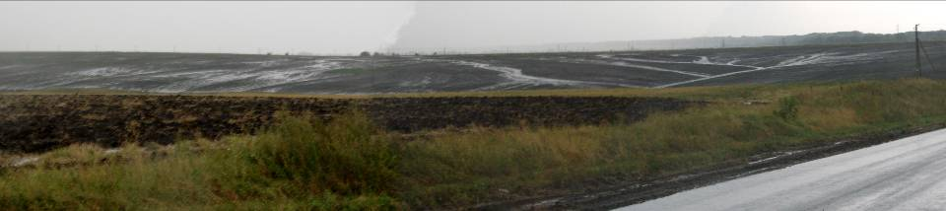
Impact of linear depressions on cultivated slopes on overland flow patterns:
Runoff concentration and increased erosion rates

Slide 12
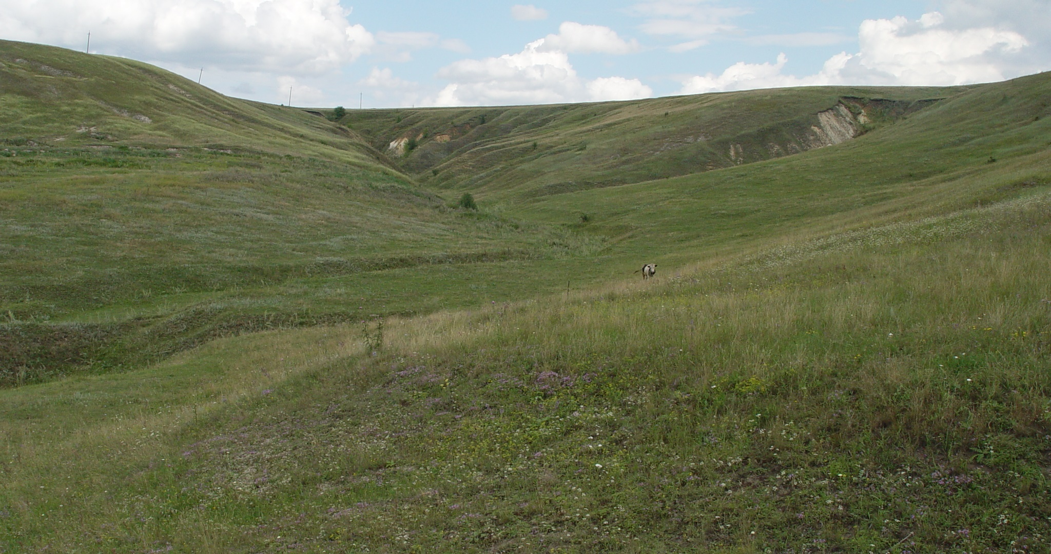
Typical modern fluvial landforms of the Central Russian Plain: Dry valley (balka) with stabilized bottom gully and active valley side gullies
Photo by A.V. Panin

Slide 13
Important questions:
How are presently existing soils and fluvial landforms influenced by buried fluvial and periglacial features of the past (reworking, partial coincidence, complete inheritance)?
To what extent existence of these relic features control modern erosion spatial pattern and dynamics as well as soil properties?
Is contemporary fluvial network more or less spatially developed (density, upslope extent) than that of the past?

Slide 14
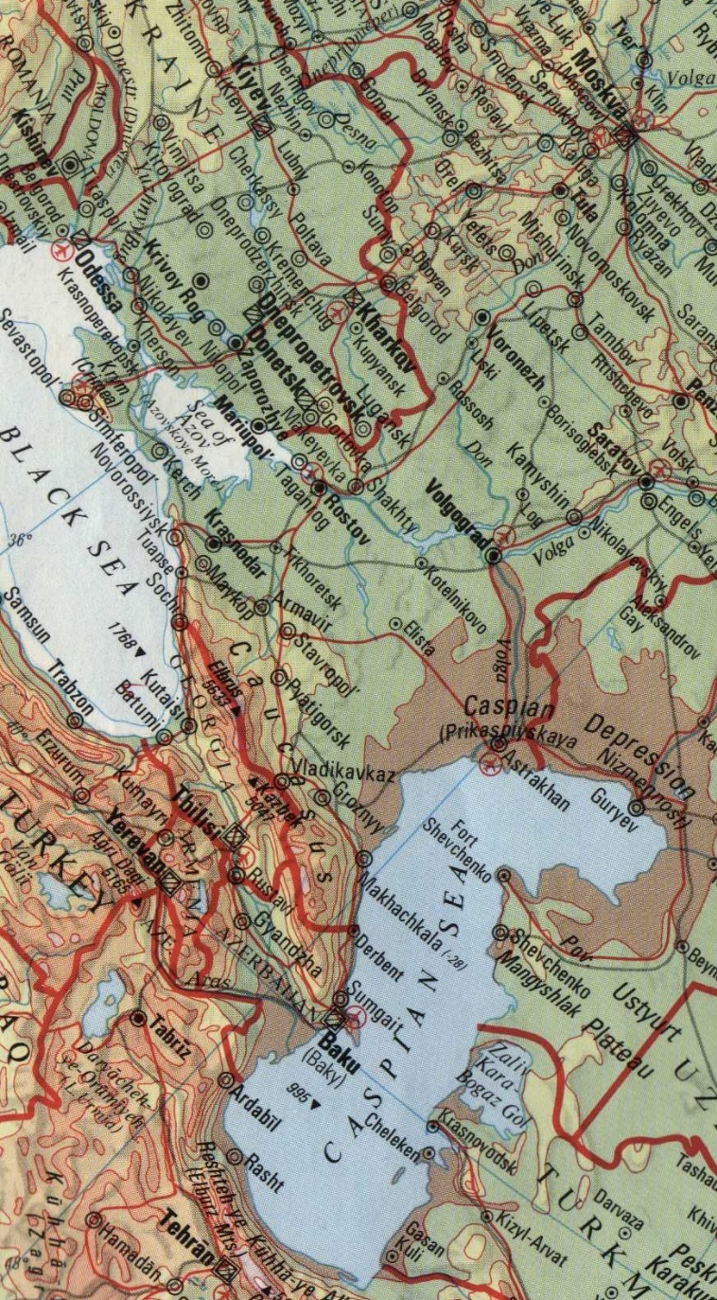
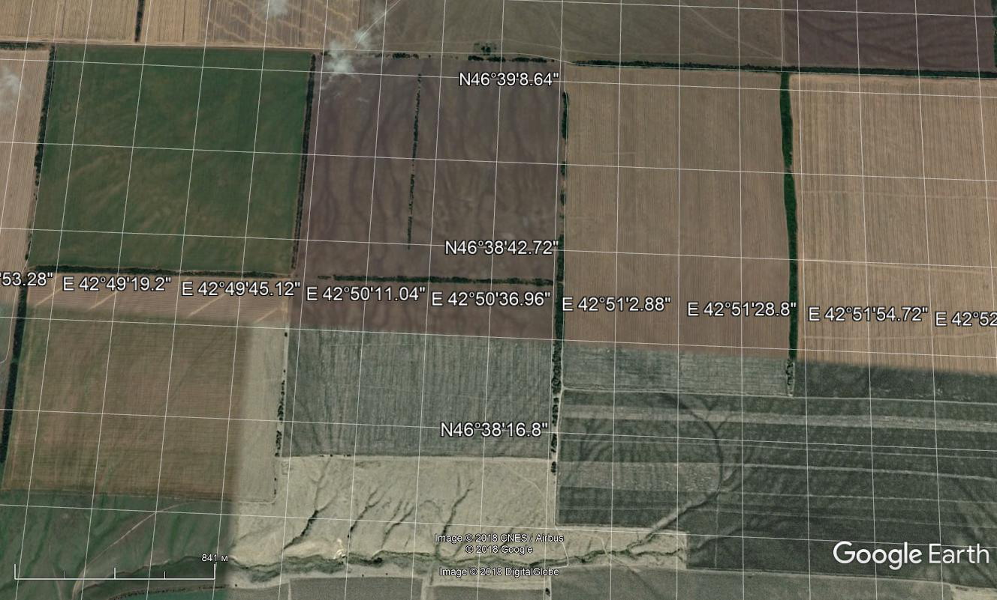
6. Ergeni Upland, Volga-Don Interfluve.
Widespread relic linear features (buried gullies) on interfluves and slopes with limited extent of polygonal features on flat interfluves
6

Slide 15
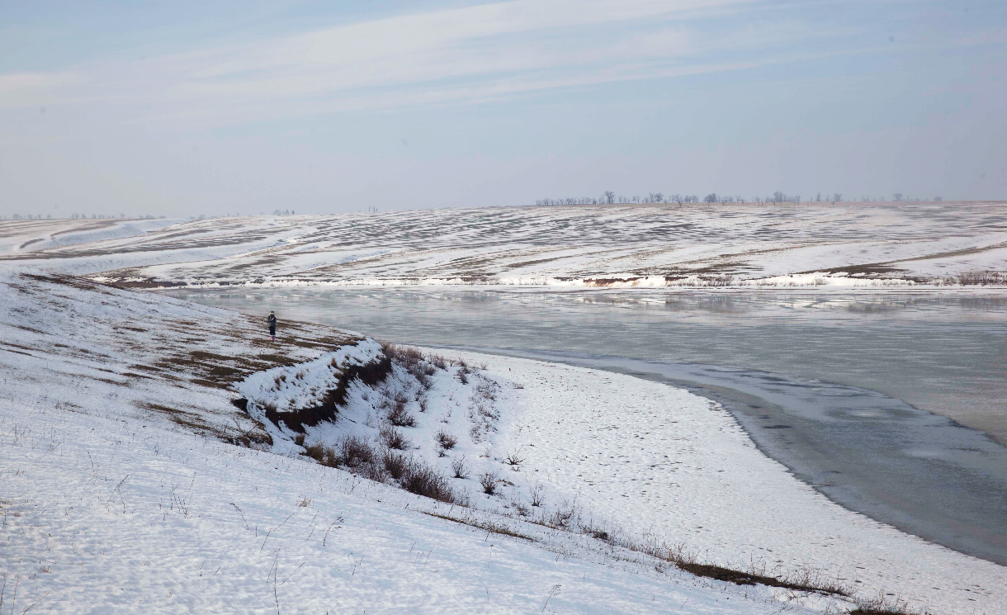
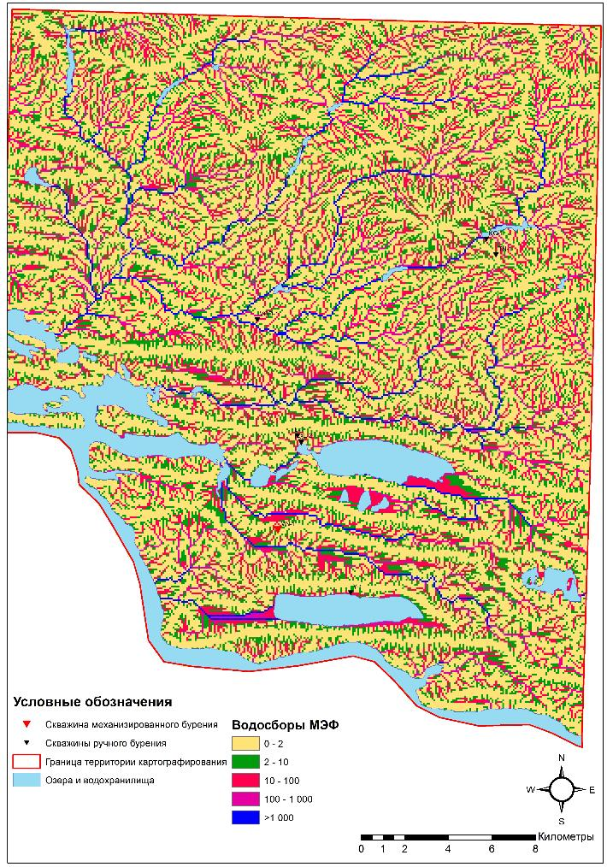
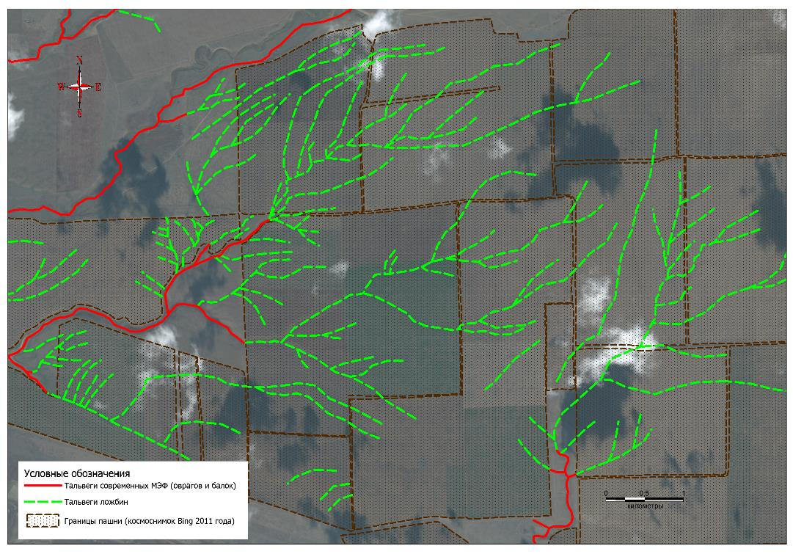
Ergeni Upland: Relic vs modern gully network and gully head contributing area map (SRTM)
Terraces representing fragments of the past gully and small valley bottoms
Relic linear depression network clearly detectable on cultivated areas is characterized by 5-fold larger density and an order of magnitude smaller head catchment areas (~ 1 ha - > 10 ha) than the modern gullies, reaching almost up to the watersheds

Slide 16
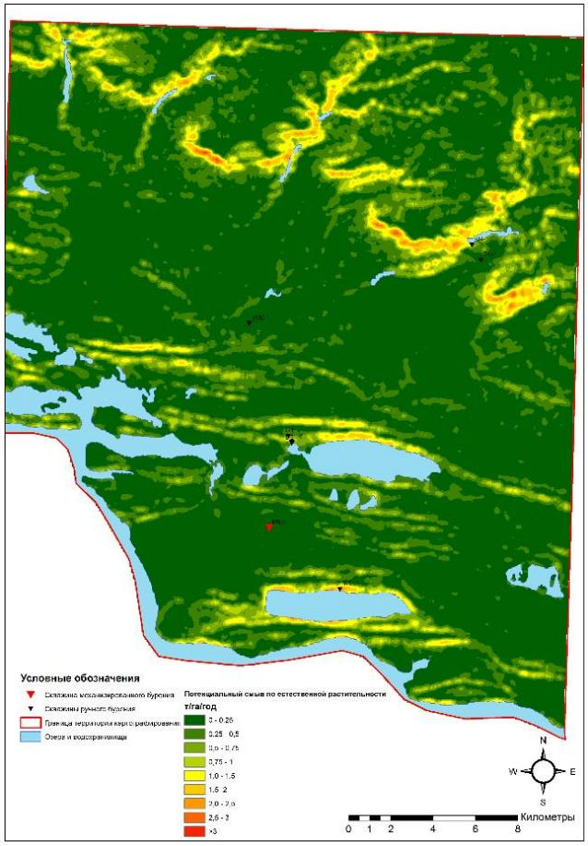
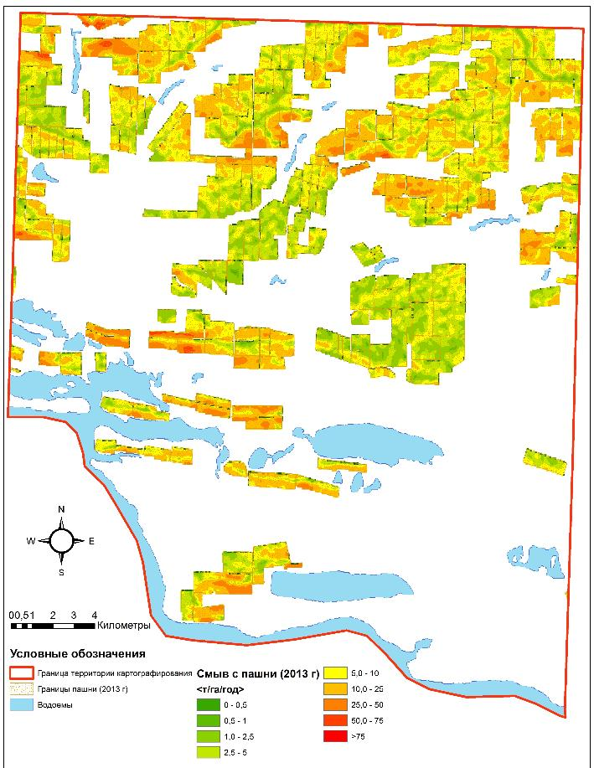
Potential soil erosion for natural dry steppe vegetation
Soil erosion (Land Use 2013) for a standard crop rotation
Tolerable soil loss for local soils
3.5 t/ha/year
% Cultivated area
Erosion rate, t/ha/year
% Total area
W_{mean} = 0.2 t/ha/year
W_{mean} = 7.5 t/ha/year
Erosion rate, t/ha/year

Slide 17
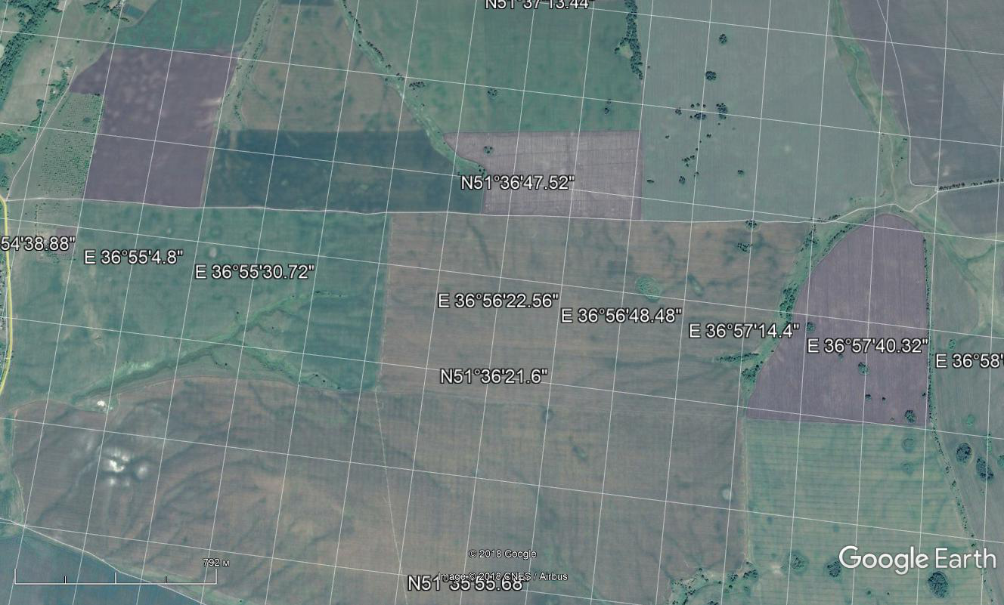
4. Lechinka case study catchment, Middle Russian Upland, Kursk Region, the Seim River basin. Forest-steppe, Chernozems Chernic (CHch) soils.
Relic polygonal features of different size and shape on rounded interfluves and gentle slopes with thermokarst depressions on flat interfluves and linear features (buried gullies) on steeper slopes.
4

Slide 18
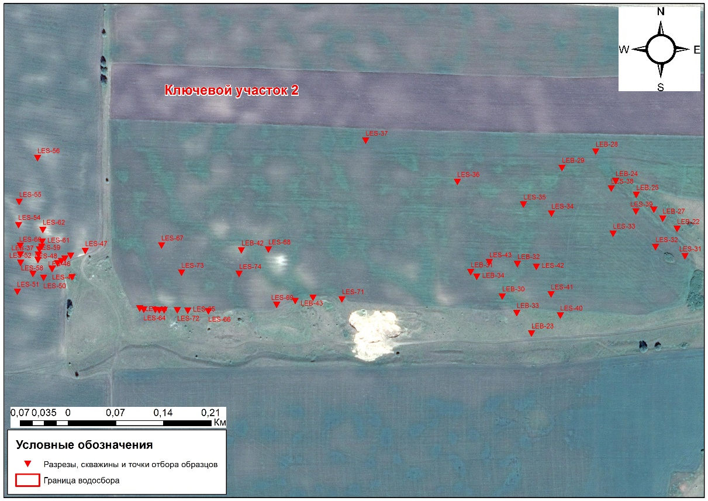
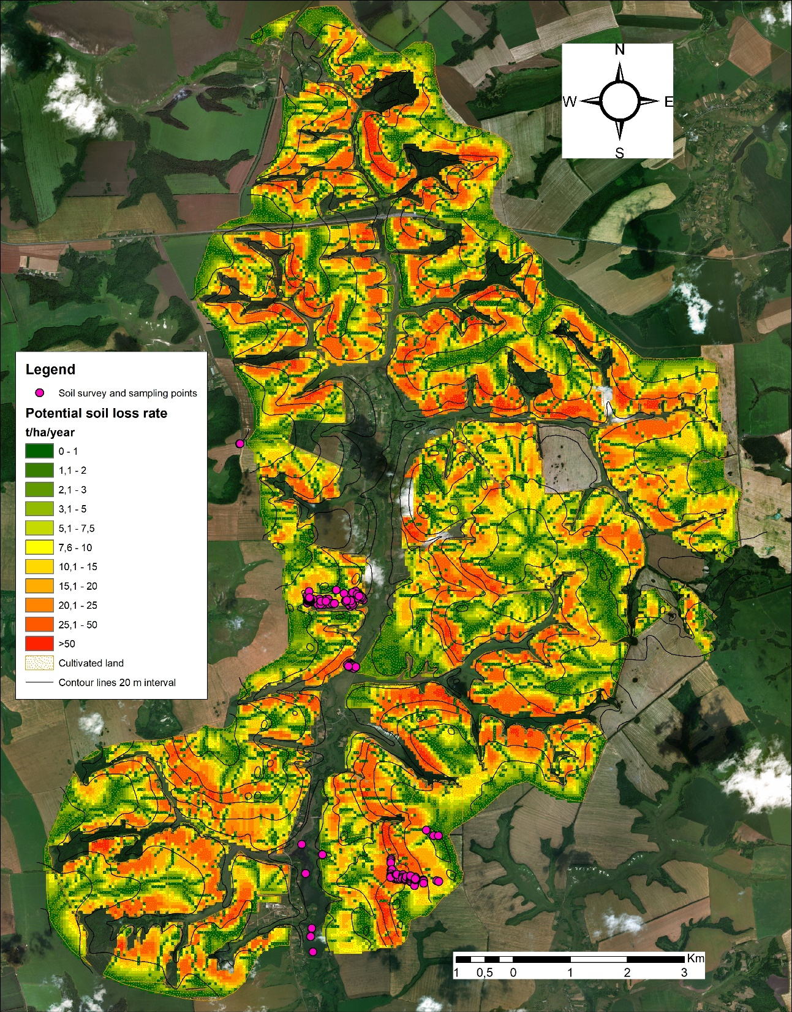
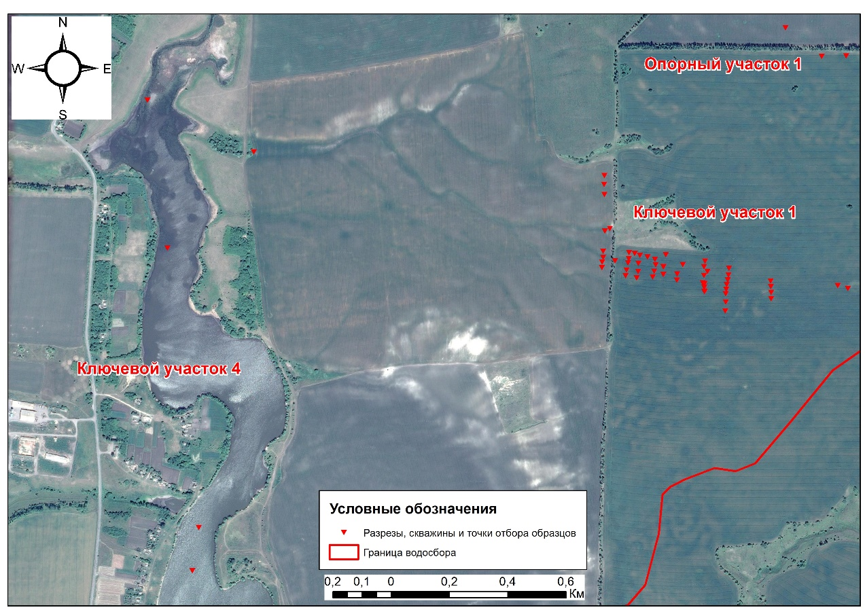

Slide 19
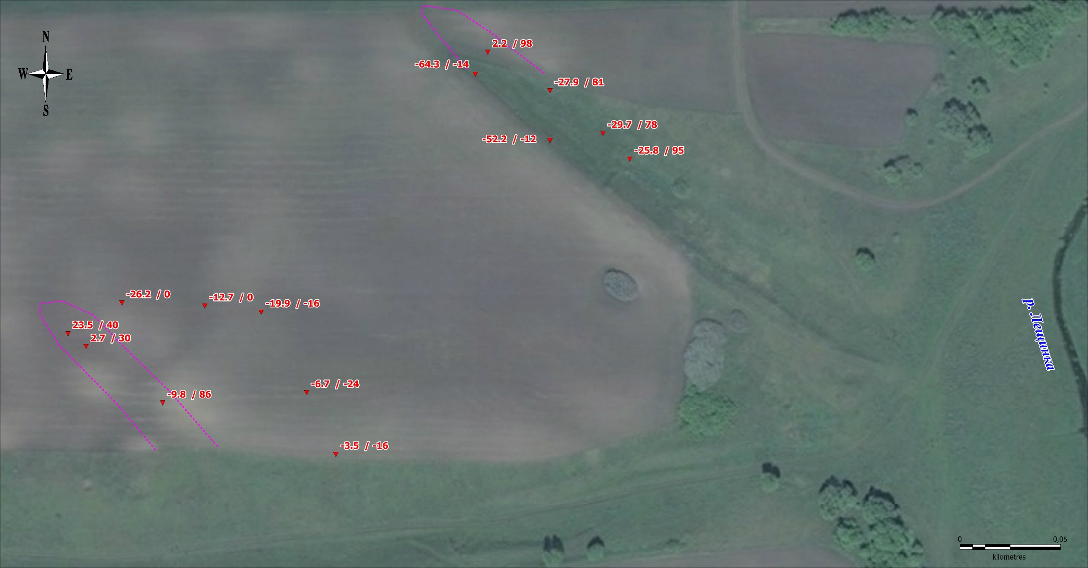
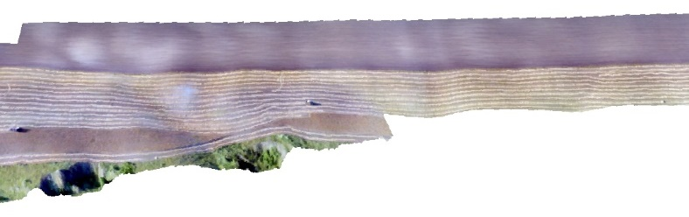
Soil redistribution rates calculated by ¹³⁷Cs / Soil profile techniques.
Purple dashed lines represent approximate boundaries of presently infilled gullies formerly incised into downslope parts of the relic polygonal network.

Slide 20
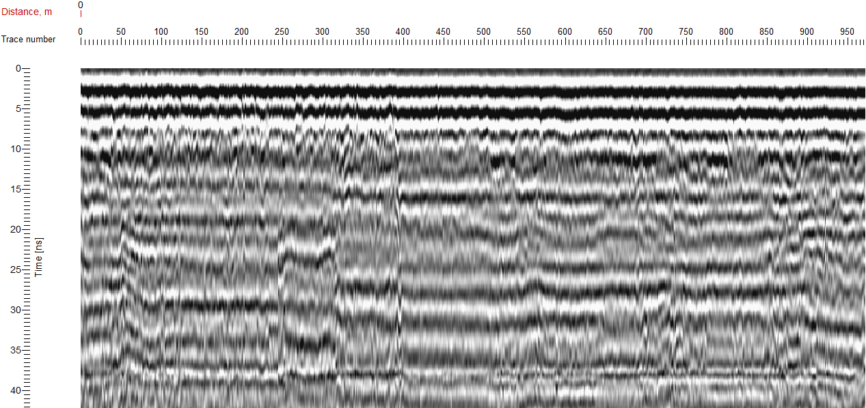
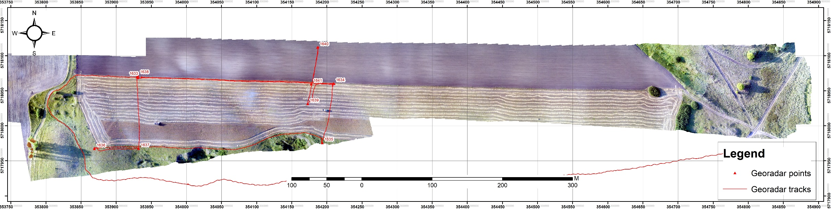
Unprocessed georadar survey data
(Line 1639-1641-1640 on the orthophotoplan)

Slide 21
Conclusions:
The W and S parts of Russian Plain are characterized by widespread and abundant relics of periglacial conditions of the past, partly preserved in topography, soil cover and surface geology.
Fluvial processes during coldest periods of the past were strongly influenced by periglacial processes, mainly solifluction.
These features exert important influence on spatial pattern of overland flow, especially runoff concentration, and, therefore, on sediment redistribution within cultivated hillslopes.
Modern gully network continues to experience influence of relic periglacial features (by partly inheriting those).

Slide 22
Research perspectives:
to analyze available data and distinguish types of the W and S Russian Plain territories by pattern and density of relic periglacial slope depression network
to find examples of such features directly observed in the field
to identify the most appropriate case study catchments
to establish basis for quantitative assessment of modern sediment redistribution on slopes with and without relic periglacial hollow networks and their comparison

Slide 23

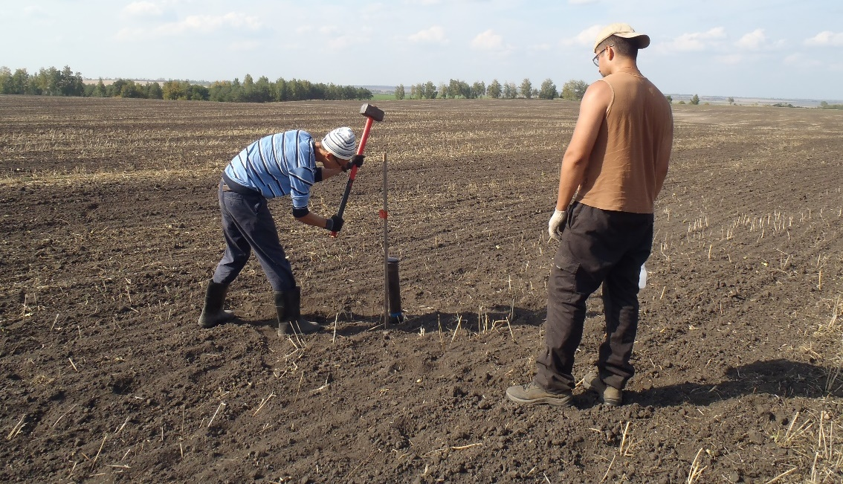
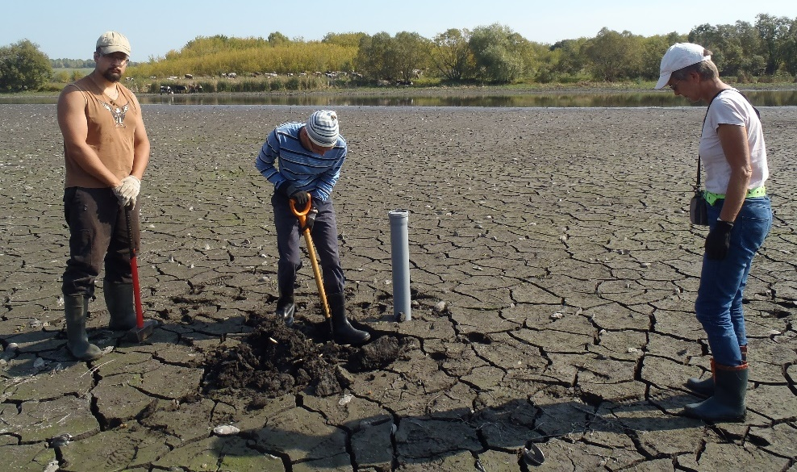
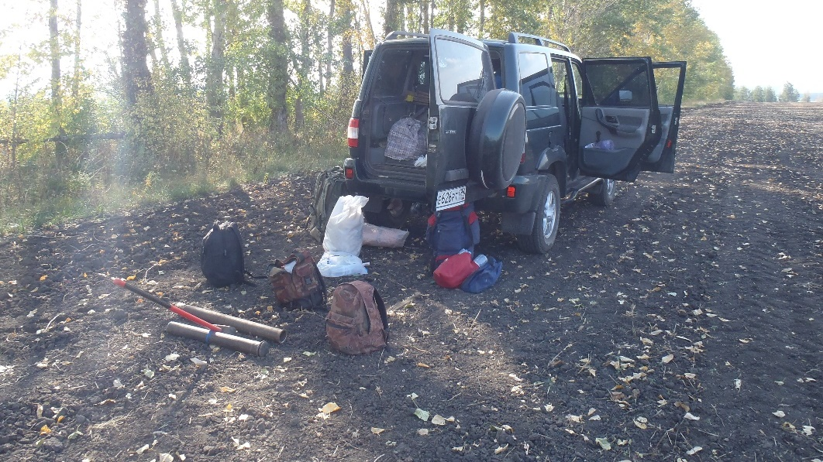
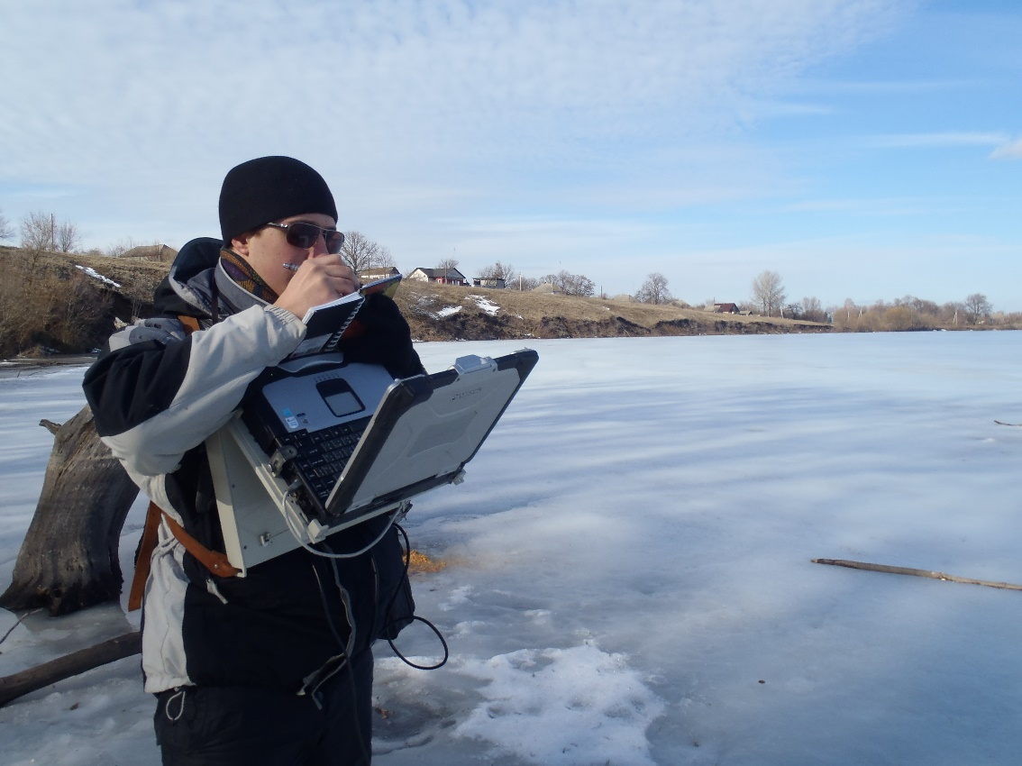
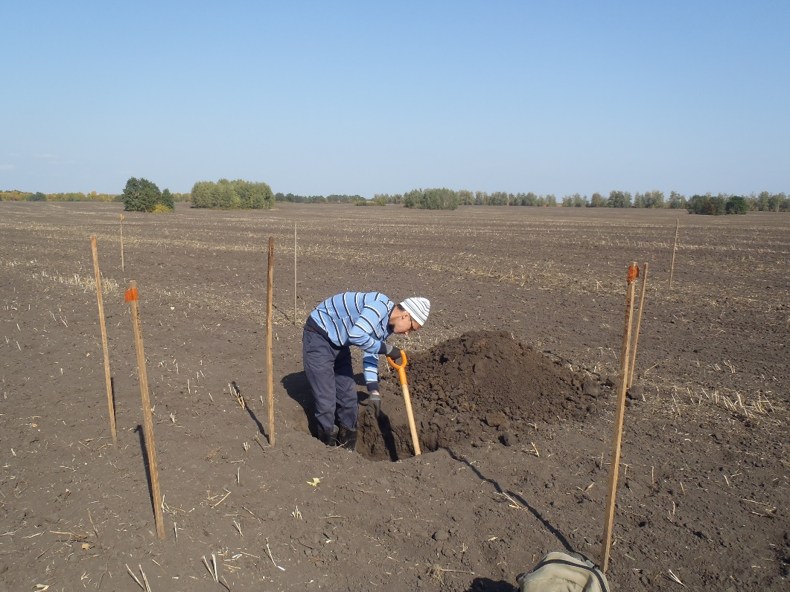
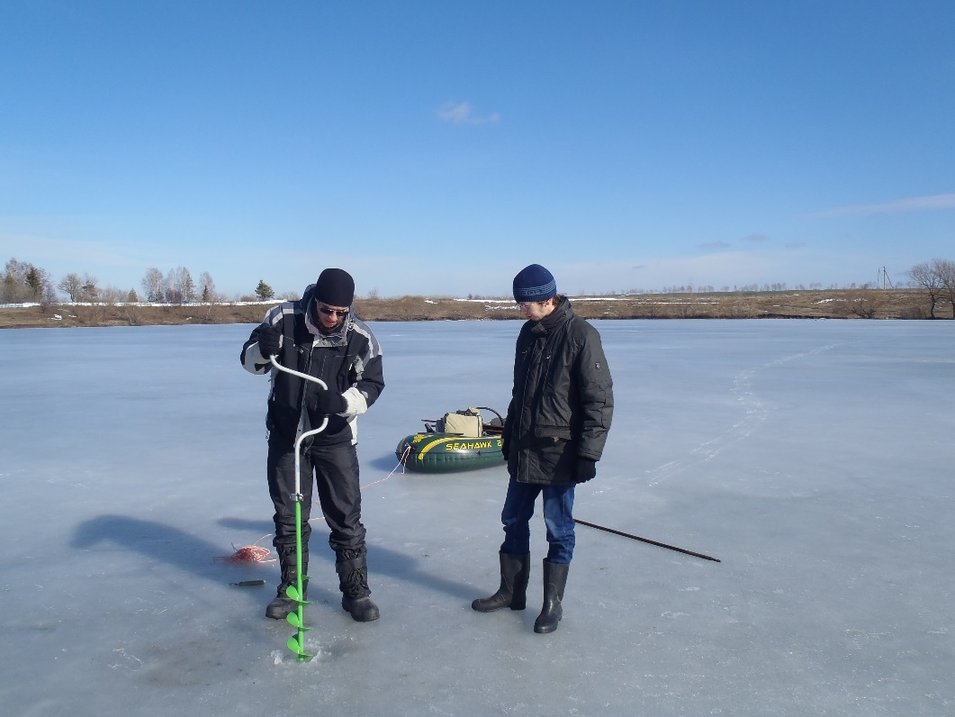
The study is supported by the RFBR project 18-05-01118a
and GM -16-116032810084-0
Thank You Very Much
For Your attention!

